Slide 1
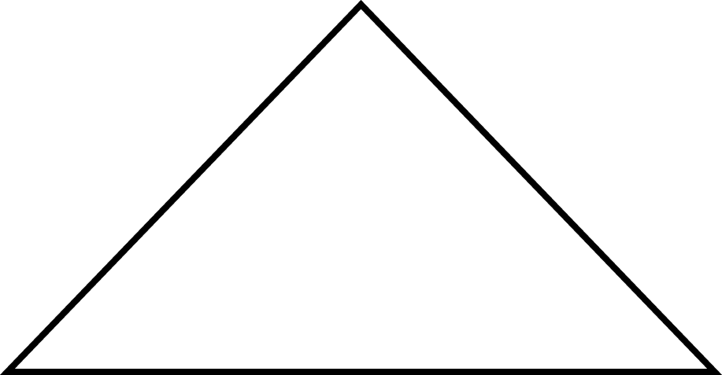
Definitions
Full Binary Tree: A binary tree in which all of the leaves are on the same level and every nonleaf node has two children

Slide 2
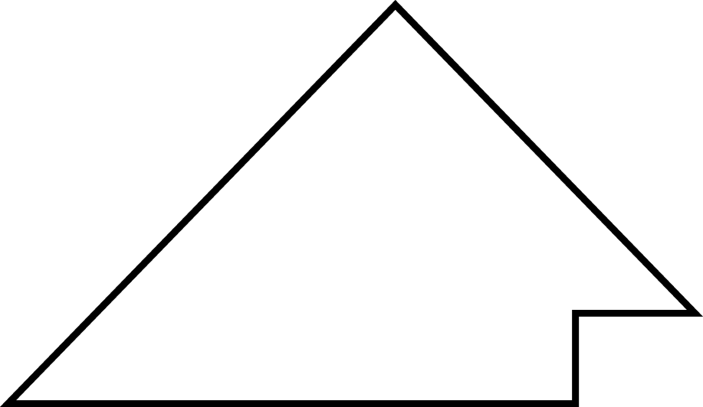
Definitions (cont.)
Complete Binary Tree: A binary tree that is either full or full through the next-to-last level, with the leaves on the last level as far to the left as possible

Slide 3
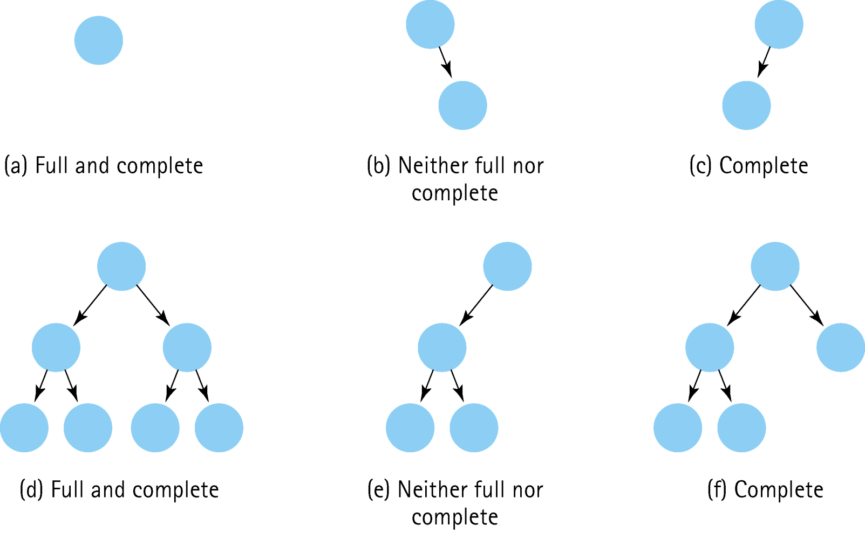
Examples of Different Types of Binary Trees

Slide 4
What is a Heap?
A heap is a binary tree that satisfies these
special SHAPE and ORDER properties:
Its shape must be a complete binary tree.
For each node in the heap, the value stored in that node is greater than or equal to the value in each of its children.

Slide 5
Are these Both Heaps?
treePtr
C
50
A
T
20
30
18
10

Slide 6
Is this a Heap?
tree
70
60
12
40
30
8
10

Slide 7
Where is the Largest Element in a Heap Always Found?
tree
70
60
12
40
30
8

Slide 8
We Can Number the Nodes Left to Right by Level This Way
tree
70
0
60
1
12
2
40
3
30
4
8
5

Slide 9
Use the Numbers as Array Indexes to Store the Heap
tree.elements
[ 0 ]
[ 1 ]
[ 2 ]
[ 3 ]
[ 4 ]
[ 5 ]
[ 6 ]
70
60
12
40
30
8
tree
70
0
60
1
12
2
40
3
30
4
8
5

Slide 10
Left child index: index*2 +1
Right child index: index*2 + 2
Parent index: (index – 1)/2

Slide 11
Heaps must preserve order and shape!
Delete: (always from root)
Take info from root
Swap info from bottom rightmost node into root. Delete this node.
Reheap down : find maxchild, swap with root if maxchild is larger. Continue to bottom of heap.

Slide 12
Heaps must preserve order and shape!
Insert: (always preserve shape)
Insert at bottom rightmost position
Reheap Up: Compare current node with parent. If current node is greater, then swap. Reheap up from parent.

Slide 13
// HEAP SPECIFICATION
// Assumes ItemType is either a built-in simple data
// type or a class with overloaded relational operators.
template< class ItemType >
struct HeapType
{
void ReheapDown ( int root , int bottom ) ;
void ReheapUp ( int root, int bottom ) ;
ItemType* elements; //ARRAY to be allocated dynamically
int numElements ;
};

Slide 14
ReheapDown
// Remember tree is heap except for root when this function is called
// Pre: root is the index of the node that may violate the
// heap order property
// Post: Heap order property is restored between root and bottom
template< class ItemType >
void HeapType<ItemType>::ReheapDown ( int root, int bottom )
{
int maxChild ;
int rightChild ;
int leftChild ;
leftChild = root * 2 + 1 ;
rightChild = root * 2 + 2 ;

Slide 15
ReheapDown (cont)
if ( leftChild <= bottom ) // ReheapDown continued
{
if ( leftChild == bottom )
maxChild = leftChild ;
else
{
if (elements [ leftChild ] <= elements [ rightChild ] )
maxChild = rightChild ;
else
maxChild = leftChild ;
}
if ( elements [ root ] < elements [ maxChild ] )
{
Swap ( elements [ root ] , elements [ maxChild ] ) ;
ReheapDown ( maxChild, bottom ) ;
}
}
}

Slide 16
ReheapUp
template< class ItemType >
void HeapType<ItemType>::ReheapUp ( int root, int bottom )
// Pre: bottom is the index of the node that may violate the heap
// order property. The order property is satisfied from root to
// next-to-last node.
// Post: Heap order property is restored between root and bottom
{
int parent ;
if ( bottom > root )
{
parent = ( bottom - 1 ) / 2;
if ( elements [ parent ] < elements [ bottom ] )
{
Swap ( elements [ parent ], elements [ bottom ] ) ;
ReheapUp ( root, parent ) ;
}
}
}

Slide 17
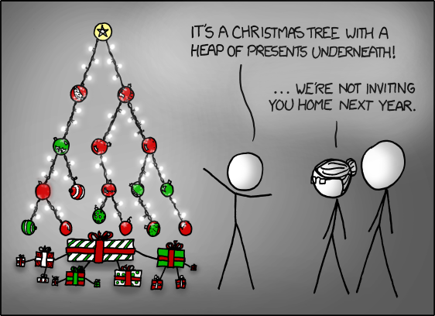
Ahhh… but the heap is not right, why???

Slide 18
Priority Queue
A priority queue is an ADT with the property that only the highest-priority element can be accessed at any time.

Slide 19
ADT Priority Queue Operations
Transformers
MakeEmpty
Enqueue
Dequeue
Observers
IsEmpty
IsFull
change state
observe state

Slide 20
Implementation Level
There are many ways to implement a priority queue
An unsorted List- dequeuing would require searching through the entire list
An Array-Based Sorted List- Enqueuing is expensive
A Reference-Based Sorted List- Enqueuing again is 0(N)
A Binary Search Tree- On average, 0(log₂N) steps for both enqueue and dequeue
A Heap- guarantees 0(log₂N) steps, even in the worst case

Slide 21
Class PQType Declaration
class FullPQ(){};
class EmptyPQ(){};
template<class ItemType>
class PQType
{
public:
PQType(int);
~PQType();
void MakeEmpty();
bool IsEmpty() const;
bool IsFull() const;
void Enqueue(ItemType newItem);
void Dequeue(ItemType& item);
private:
int length;
HeapType<ItemType> items;
int maxItems;
};

Slide 22
Class PQType Function Definitions
template<class ItemType>
PQType<ItemType>::PQType(int max)
{
maxItems = max;
items.elements = new ItemType[max];
length = 0;
}
template<class ItemType>
void PQType<ItemType>::MakeEmpty()
{
length = 0;
}
template<class ItemType>
PQType<ItemType>::~PQType()
{
delete [] items.elements;
}

Slide 23
Class PQType Function Definitions
Dequeue
Set item to root element from queue
Move last leaf element into root position
Decrement length
items.ReheapDown(0, length-1)
Enqueue
Increment length
Put newItem in next available position
items.ReheapUp(0, length-1)

Slide 24
Code for Dequeue
template<class ItemType>
void PQType<ItemType>::Dequeue(ItemType& item)
{
if (length == 0)
throw EmptyPQ();
else
{
item = items.elements[0];
items.elements[0] = items.elements[length-1];
length--;
items.ReheapDown(0, length-1);
}
}

Slide 25
Code for Enqueue
template<class ItemType>
void PQType<ItemType>::Enqueue(ItemType newItem)
{
if (length == maxItems)
throw FullPQ();
else
{
length++;
items.elements[length-1] = newItem;
items.ReheapUp(0, length-1);
}
}

Slide 26
Comparison of Priority Queue Implementations
Enqueue
Dequeue
Heap
O(log₂N)
O(log₂N)
Linked List
O(N)
O(N)
Binary Search Tree
Balanced
O(log₂N)
O(log₂N)
Skewed
O(N)
O(N)

Slide 27
Definitions
Graph: A data structure that consists of a set of models and a set of edges that relate the nodes to each other
Vertex: A node in a graph
Edge (arc): A pair of vertices representing a connection between two nodes in a graph
Undirected graph: A graph in which the edges have no direction
Directed graph (digraph): A graph in which each edge is directed from one vertex to another (or the same) vertex

Slide 28
Graphs
a graph G is defined as follows:
G = (V,E)
where
V(G) is a finite, nonempty set of vertices
E(G) is a set of edges (written as pairs of vertices)

Slide 29
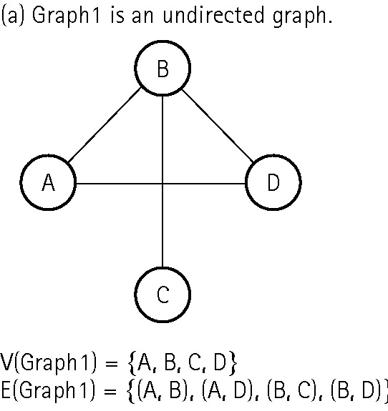
An undirected graph

Slide 30
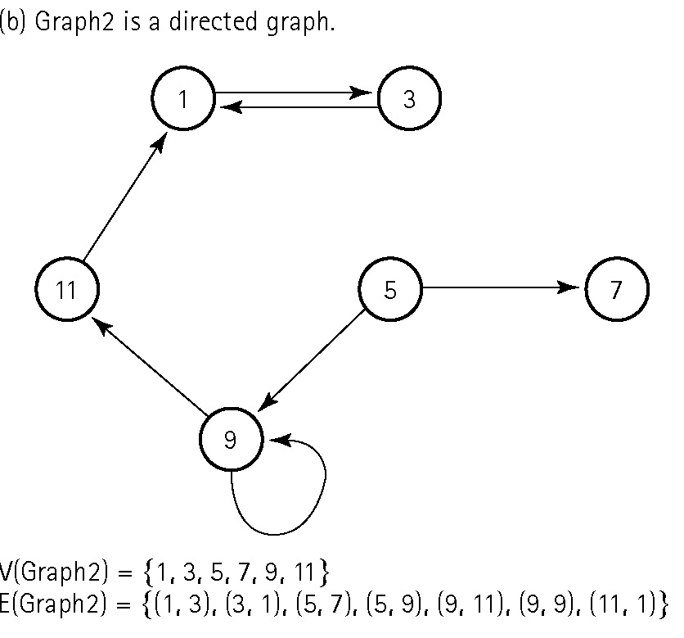
A directed graph

Slide 31
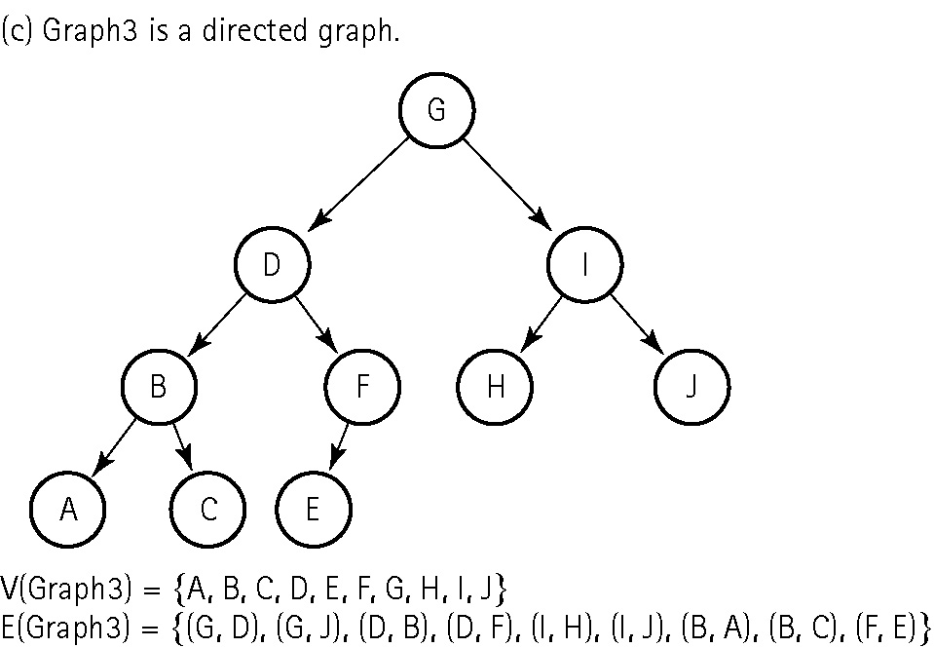
A directed graph

Slide 32
More Definitions
Adjacent vertices: Two vertices in a graph that are connected by an edge
Path: A sequence of vertices that connects two nodes in a graph
Complete graph: A graph in which every vertex is directly connected to every other vertex
Weighted graph: A graph in which each edge carries a value

Slide 33
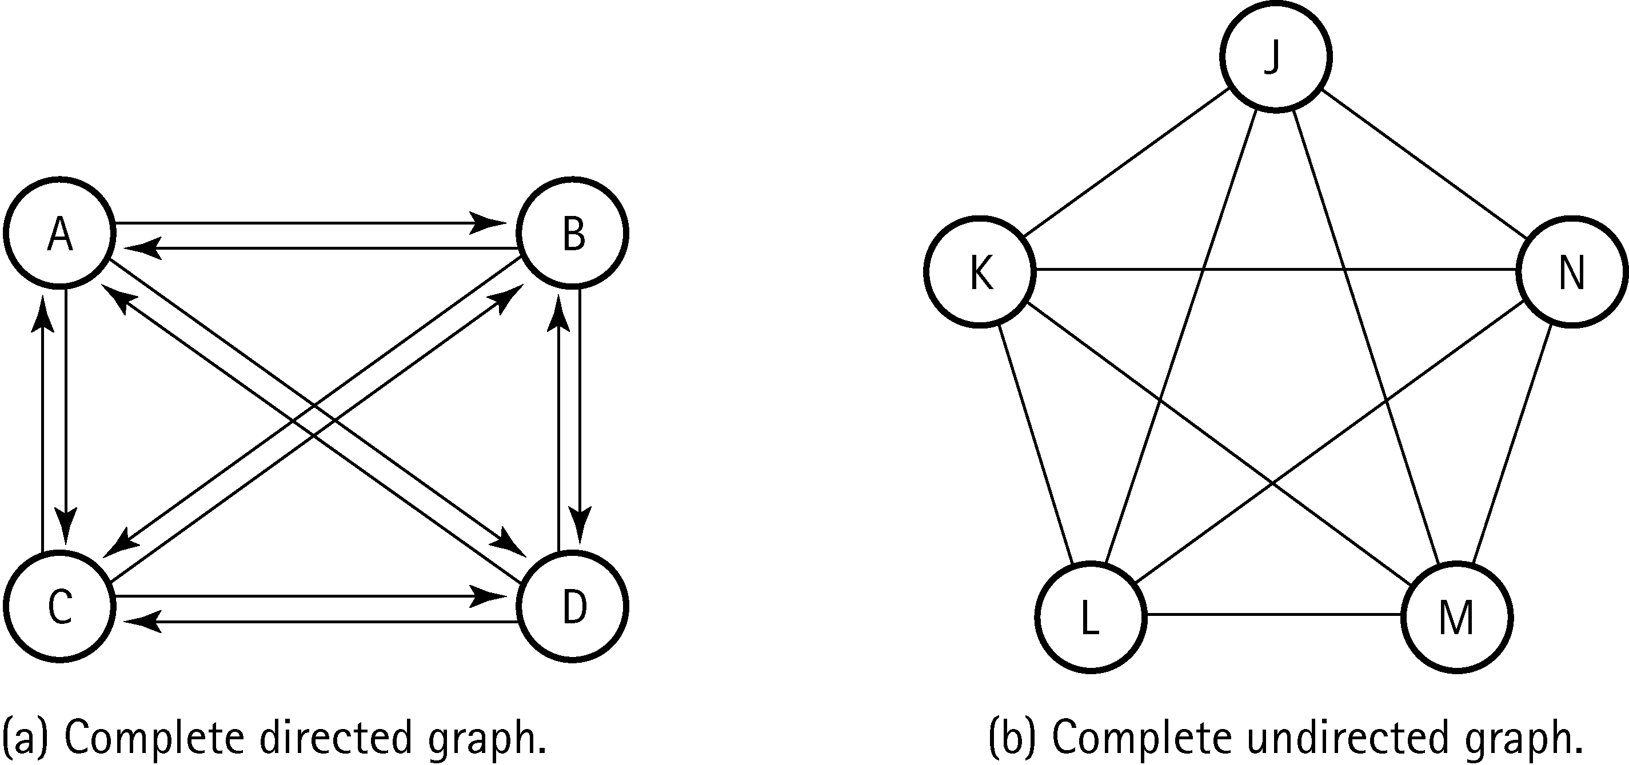
Two complete graphs

Slide 34
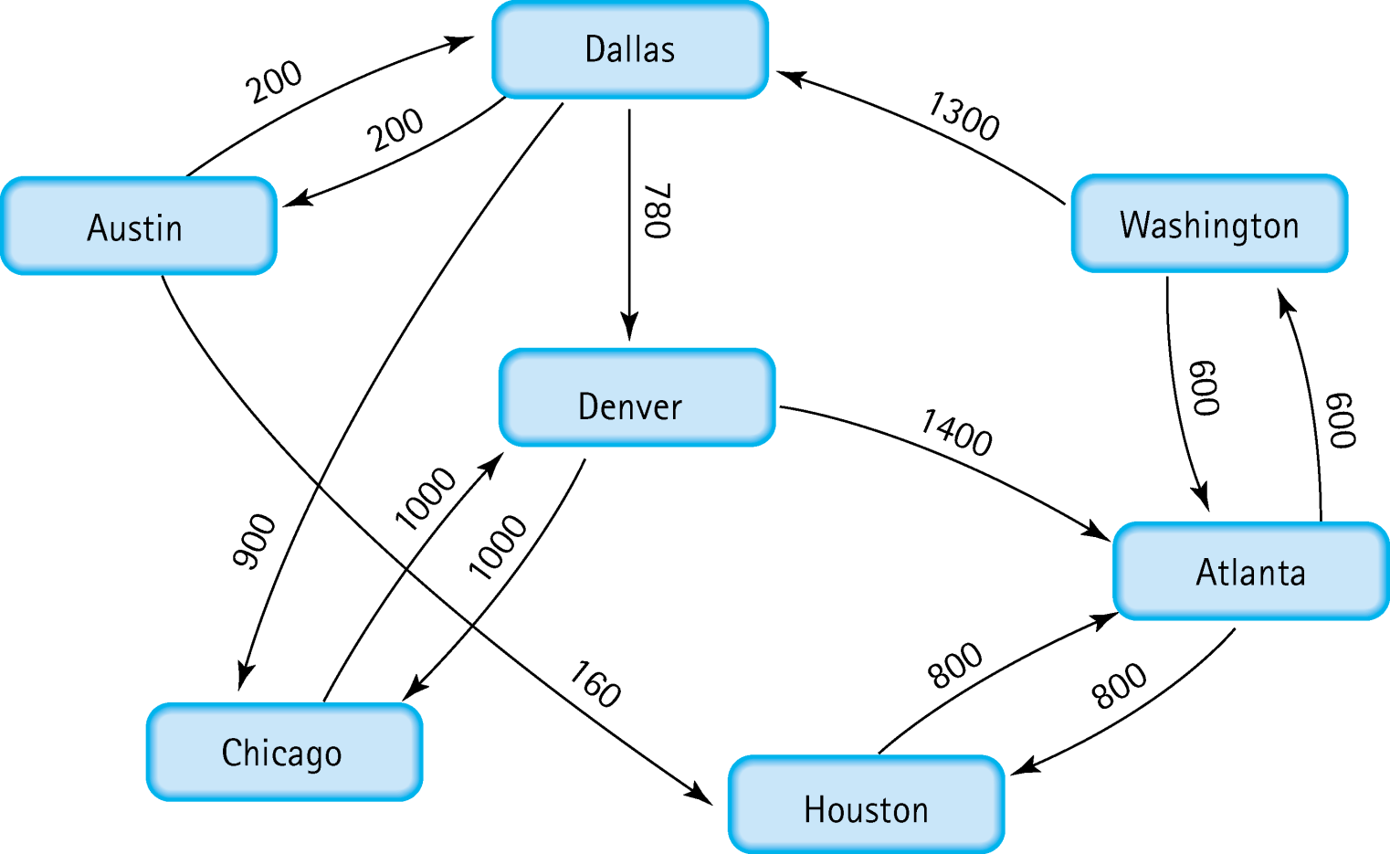
A weighted graph

Slide 35
Definitions
Depth-first search algorithm: Visit all the nodes
in a branch to its deepest point before moving up
Breadth-first search algorithm: Visit all the nodes on one level before going to the next level
Single-source shortest-path algorithm: An algorithm that displays the shortest path from a designated starting node to every other node in the graph

Slide 36
Array-Based Implementation
Adjacency Matrix: for a graph with N nodes, an N by N table that shows the existence (and weights) of all edges in the graph

Slide 37
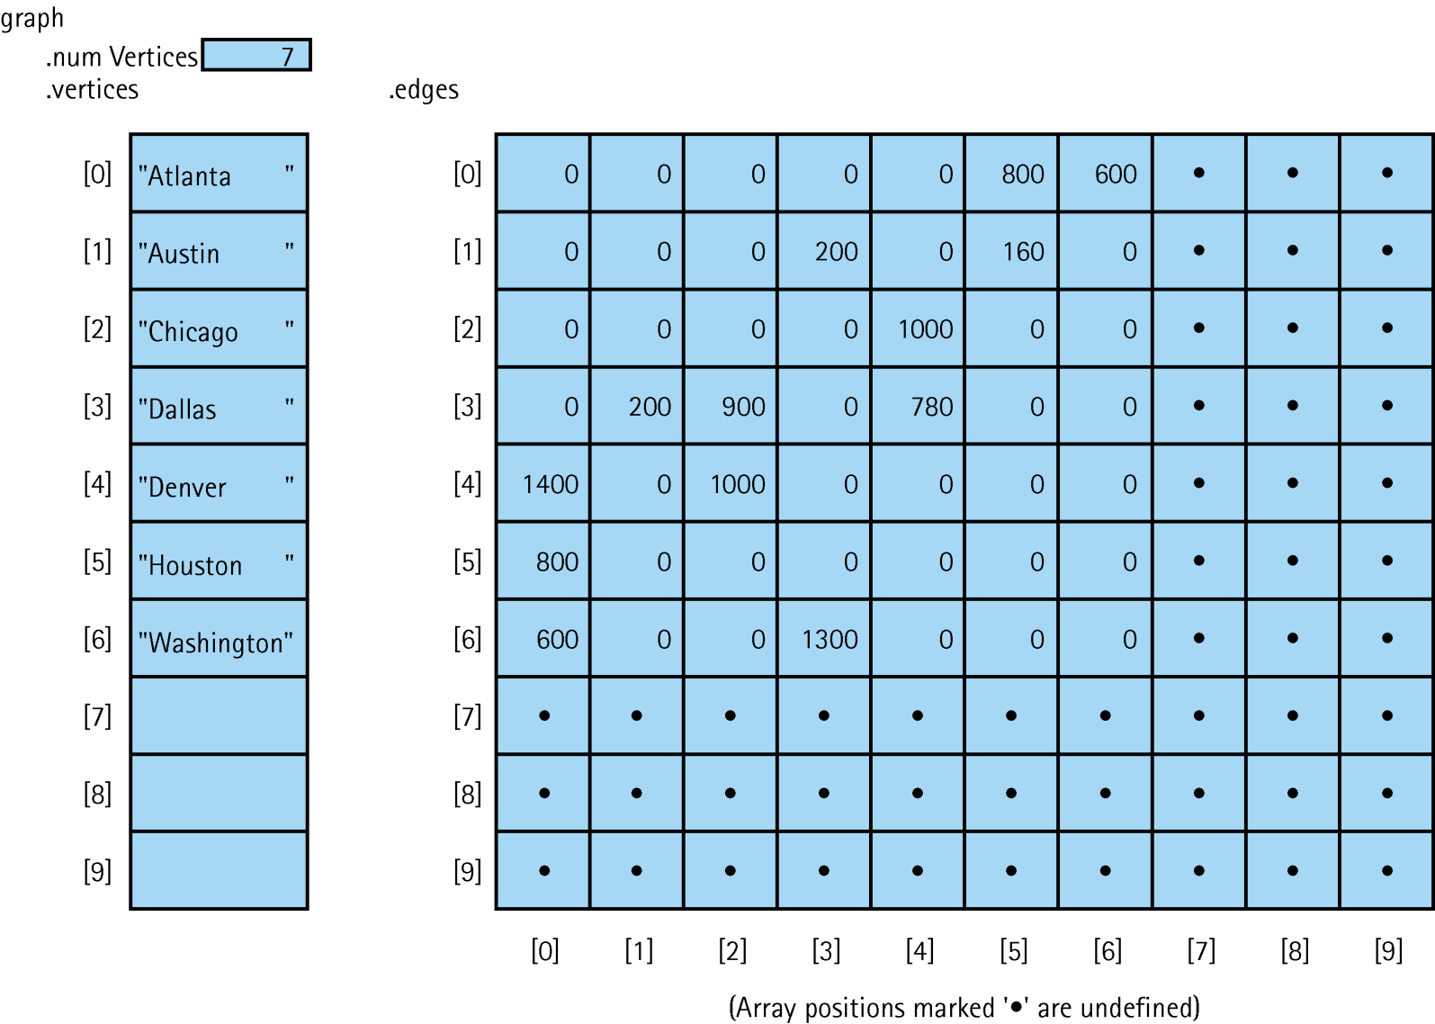
Adjacency Matrix for Flight Connections

Slide 38
Linked Implementation
Adjacency List: A linked list that identifies all the vertices to which a particular vertex is connected; each vertex has its own adjacency list

Slide 39
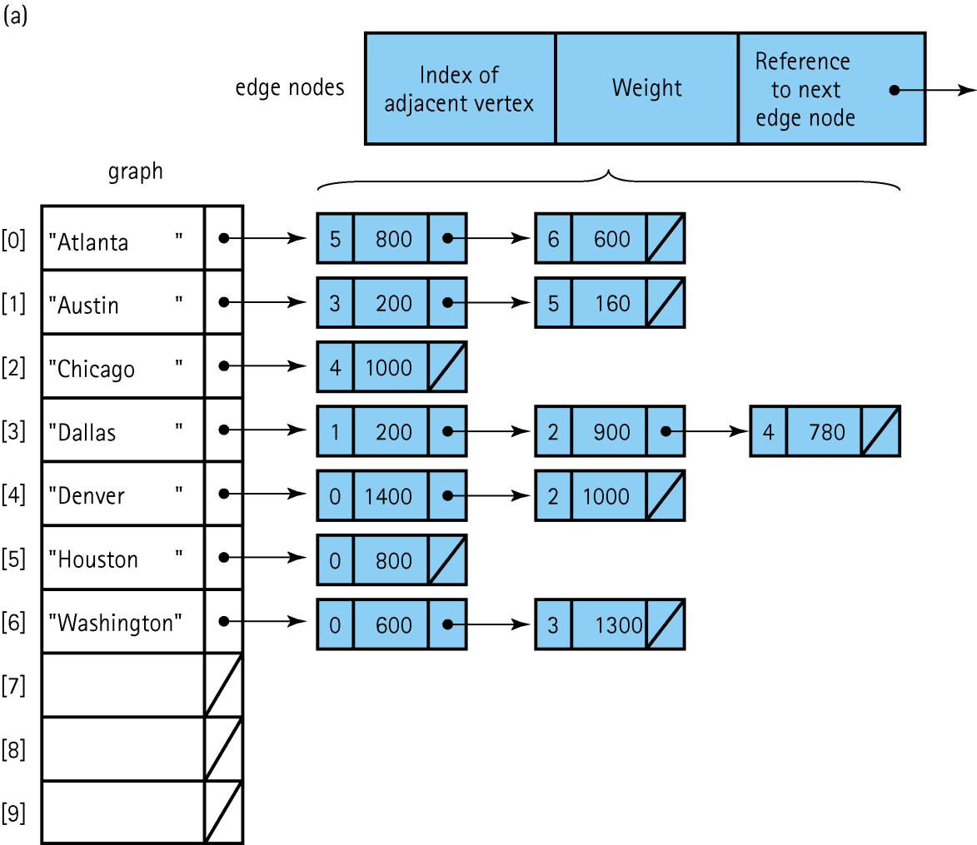
Adjacency List Representation of Graphs

